Slide 1

“Technology is a tool not a goal”
Caireen Sutherland
Head of Education, RNIB
QTVI and QTMSI

Slide 2
Contents
Accessibility – two fold
Considerations
Examples

Slide 3
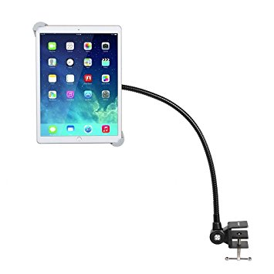
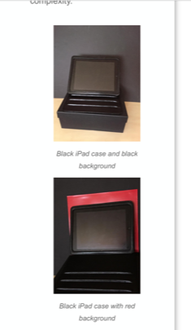
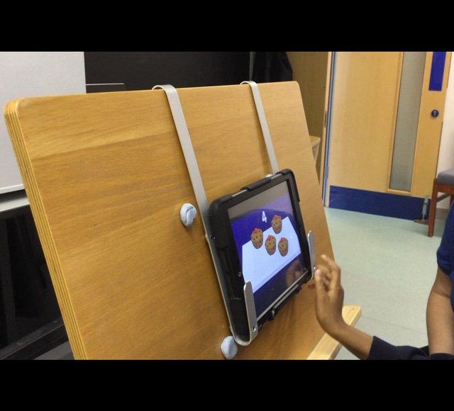
Access 1

Slide 4
Access 2
Accessible
Adaptable
Interactive
Notes:
Access 2

Slide 5
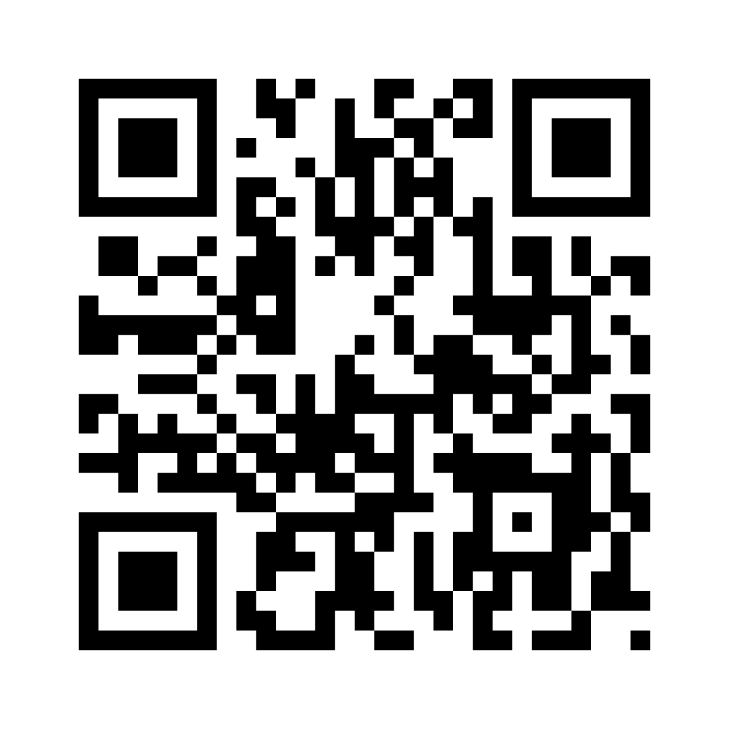
Examples
Apps for
  Access – Bookcreator, Choiceboard, Voice Memo, Tag to tap
  Visual Skills – Movepaint, Particlescape, Baby bubbles
QR Codes

Slide 6
Lights, camera, action
Camera and video
  Perspective
  Purpose
Action

Slide 7
Outcomes
Real World
Skills Ladders
Feedback

