Slide 1

Local area inspections –
What good looks like
NatSIP National Working Day and HoSS Event
Wednesday 5 February 2019
André Imich, SEN and Disability Professional Adviser, DfE

Slide 2
The focus of inspection
In May 2016, Ofsted and CQC started a new type of joint inspection. The aim is to hold local areas to account and champion the rights of children and young people with SEND
Inspectors consider how effectively the local area:
identifies need;
meets need; and
improves the outcomes
of the wide range of different groups of children and young people who have SEND.

Slide 3
Key lines of enquiry
  The accuracy and rigour of the service’s self-evaluation
  To what extent the outcomes for CYP are improving as a result of the collective actions and support of local agencies and bodies
  The efficiency of identification of SEND
  The timeliness and usefulness of assessment
  How well the service engages with CYP, and their parents and carers
  How well the local area involves the individual CYP, and their parents and carers, in the process of assessing their needs
  How well the local area communicates with CYP, and their parents or carers
  The extent to which the local area gives due regard to its duties under the Equality Act

Slide 4

Implementation of the SEND reforms –
Local Area Inspection Evidence
2. All parties meet their statutory duties
1. Co-production with children, young people and parents
3. Increased satisfaction with access to local services
8. Improved parental confidence
4. Accurate and timely identification of SEN and disability
7. More YP go on to post-16 education, training & employment
5. Improved attainment and narrowing of gap for CYP with SEND
6. Strong focus on those at SEN Support

Slide 5
Co-production with children, young people and parents–
West Sussex (2018) - The PCF is a key partner in driving through the reforms in the local area. It has demonstrated that it plays an effective role in co-producing services with local area leaders, while representing the views of parents and carers robustly and with compassion.
Wigan (2018) - The local parent carer forum is a valued partner. Engagement and co-production is a strength of Wigan. The local PCF has been instrumental in putting together the new local offer and the co-production of the planned neuro-developmental pathway. Children and young people also play an important role.
2. All parties meet their statutory duties –
St Helens (2018) - Across the local area, leaders and managers ensure that the statutory duties, as set out in the code of practice, are at the heart of the work of services working with children and young people who have SEN and/or disabilities.

Slide 6
3. Increased satisfaction with access to local services (I) –
Northumberland - Effective support from specialist support services, such as the sensory and SEND support services….and North East Lincolnshire - Effective support from the educational team for hearing and vision…….. is helping many schools and settings to identify children and young people’s needs effectively
Milton Keynes - Babies and young children who have hearing impairment are swiftly identified. Infants have rapid access to further audiology assessment when needed. Consequently, the extra help and support these young children need is offered without delay.

Slide 7
3. Increased satisfaction with access to local services (II)
Newcastle - Services to identify, meet and support the needs of children and young people who have a visual or hearing impairment are a strength
North Somerset - Examples of the SEND reforms being successfully implemented by a number of practitioners……the HI service was one such example. Timely, clear and helpful advice to schools and parents from this service is welcomed.
Cheshire East - Robust pathways are used by the hearing and visually impaired services that support early identification. This leads to the effective assessment and meeting of these children’s needs, which is praised by parents and school leaders.

Slide 8
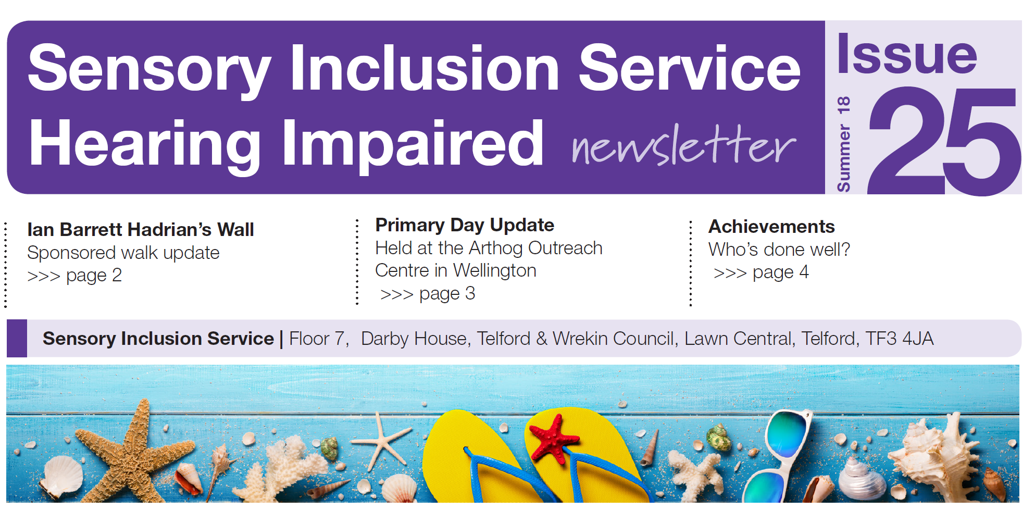
Telford and Wrekin: “Parents and carers value the information, help, advice and guidance that the sensory inclusion services provide. The assessments of children’s and young people’s visual and hearing impairments are timely and effective in meeting the needs of CYP” (SEND Inspection)

Slide 9

Lincolnshire- Service information

Slide 10
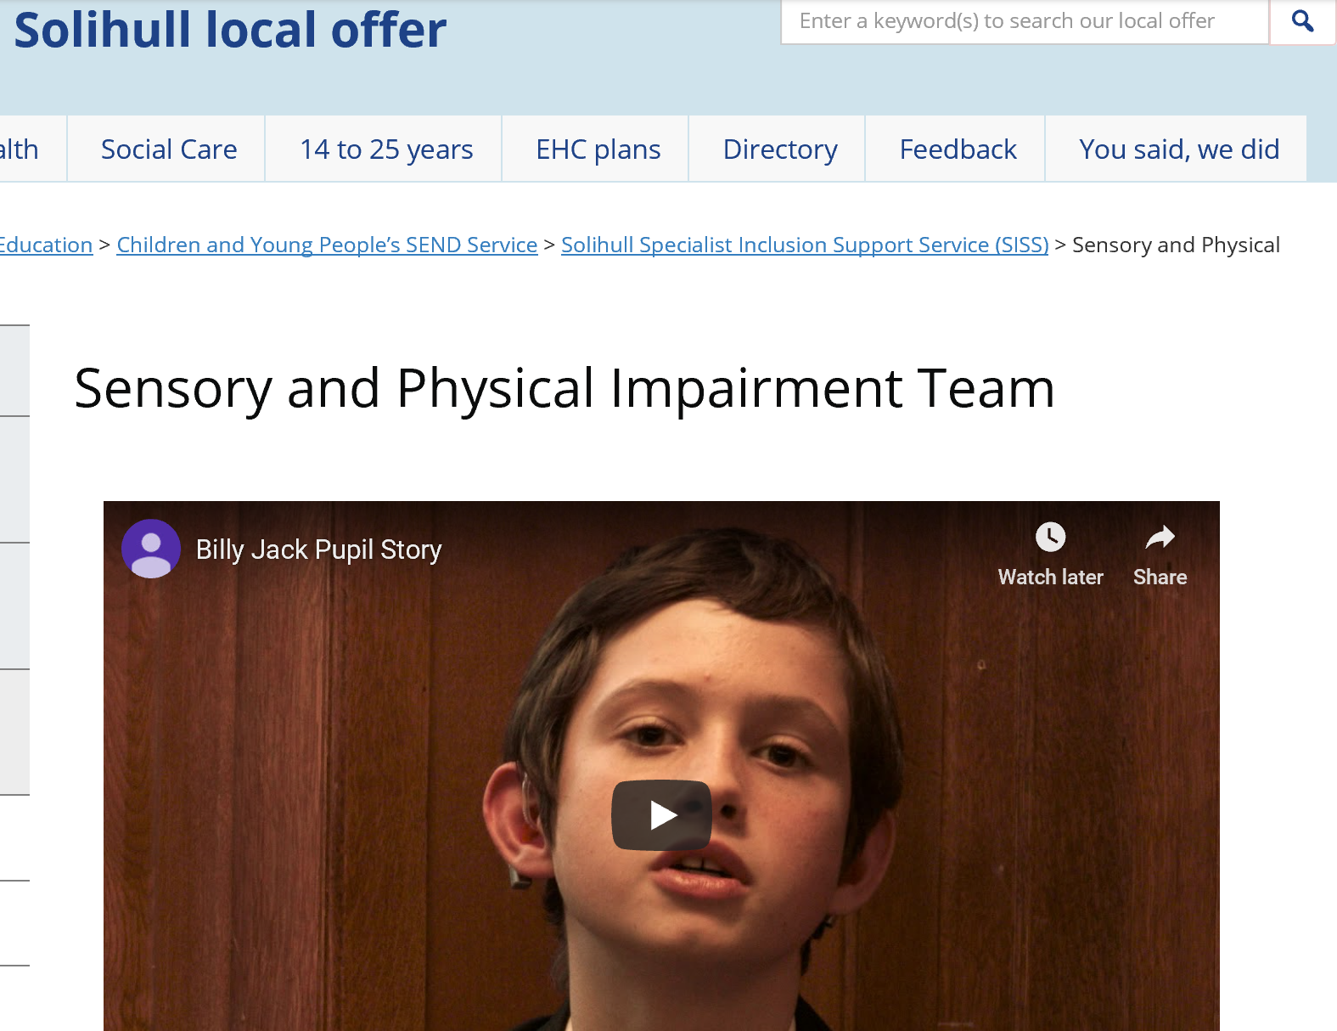
http://socialsolihull.org.uk/localoffer/education/children-and-young-peoples-send-service/solihull-inclusion-support-service-siss/sensory-and-physical-impairment-team-2/

Slide 11


Slide 12
4. Accurate and timely identification of SEN and disability
Milton Keynes - Proportion of new EHC plans completed within the expected 20-week timescale is higher than seen nationally. Leaders across the local area are working well together to continually enhance the quality of EHC needs assessments and plans
West Berkshire - EHC plans are of good quality and completed on time. EHC plans include precise and relevant educational outcomes. Suitable provision is clearly identified.
Wigan - Leaders have ensured that education, health and social care staff all contribute meaningfully to plans and that the voices of the child and family are evident.
Havering - The systems for EHC plan assessments are sound. SENCos get support on how to provide better information for the assessment. Health visitors and school nurses increasingly contribute to EHC plans with good-quality reports.

Slide 13
5. Improved attainment and narrowing of gap for CYP with SEND
Lincolnshire - In 2018, the proportion of pupils on SEN Support who achieved the combined standard in reading, writing and mathematics increased.
Kingston-upon-Thames - Learners who have learning difficulties and disabilities at ages 16 to 18, and 19+ achieve well in relation to their peers overall. There is also clear evidence of improving outcomes for young people who are aged 16-25.
Hearing impairment and MSI - Over the four years of data collection, there has been year on year improvement in the % achieving the ‘expected’ standard of phonic decoding
(NATSIP Outcomes Benchmarking Report 2017-7).

Slide 14
6. Strong focus on those at SEN Support -
Lincolnshire - School improvement initiatives to raise outcomes for children and young people who receive SEND support have been successful.
7. More YP go on to post-16 education, training & employment
Milton Keynes - Children and young people are prepared well for the next stage in their education, training or employment.
Stockport - An increasing proportion of young people move on to employment, education and training.
8. Improved parental confidence –
Plymouth - Around three quarters of the parents and carers felt that outcomes for their child were improving.
Brighton and Hove - Many parents report positively about their experiences of the support they have been offered by different commissioning services prior to, during and after identification of need.

Slide 15
Implementation of the SEND reforms –
What is your evidence base?
2. All parties meet their statutory duties
1. Co-production with children, young people and parents
3. Increased satisfaction with access to local services
8. Improved parental confidence
4. Accurate and timely identification of SEN and disability
7. More YP go on to post-16 education, training & employment
5. Improved attainment and narrowing of gap for CYP with SEND
6. Strong focus on those at SEN Support

Slide 16
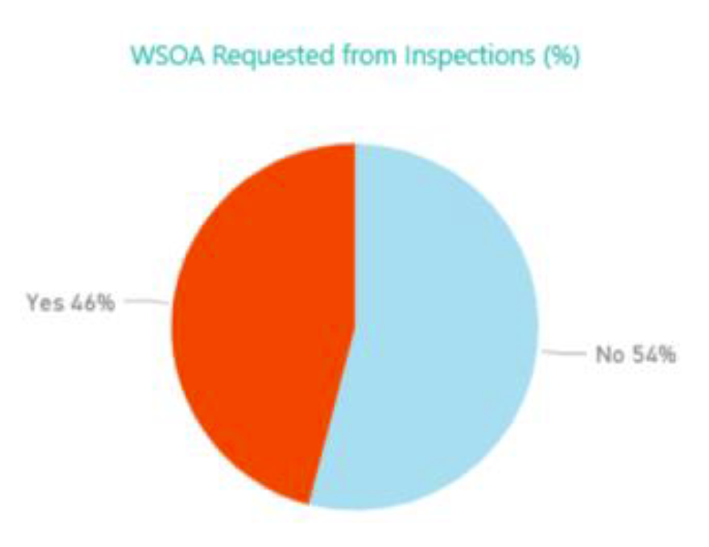
Local area SEND inspections are a key part of holding local areas to account
As at December 2018:
78 local areas inspected and letters published
34 local areas require Written Statement of Action (WSoA)

Slide 17
SEND inspections – common areas of strength
Strong strategic leadership that has led to established joint working between education, health and care services.
Early Years services – good levels of parental satisfaction
Co-production - parents, professionals, children and young people are working effectively together to devise and implement improvements
Strong health engagement, inc DCO/ DMO in place

Slide 18
WSoAs – common areas of serious weaknesses

Slide 19
Challenges for local areas
Ensuring that SEND covers the ‘14.4%’, not just the ‘2.9%’
Improving quality and outcomes
Funding and value for money
Working with partners:
  health and social care partners
  parents and young people
Mainstreaming in a context of increasing diversity of school and FE provision - Inclusion
Preparation for Adulthood

Slide 20

Effective specialist services
Support and outreach services promote inclusion and improve the life chances of many vulnerable pupils.
All staff are thoroughly committed to inclusion.
Co-produce, and communicate well, with parents and CYP.
Support service staff are particularly valued where they bring knowledge and skills usually unavailable in a mainstream school; when they demonstrate effective strategies for others to observe.
Services in LAs avoid ‘overlapping’
Work in partnership with LA school improvement services to analyse data and target their resources where the standards achieved by pupils with SEN were too low.
Measure their impact on pupils’ progress and attainment and have agreed standards against which services are evaluated.

Slide 21
Questions for sensory impaired services
To gather evidence about the effectiveness of the local area in improving outcomes for children and young people who have SEND, inspectors will evaluate how well the local area uses specialist services and its impact on outcomes.
How effectively does your service:
identify need;
meet need; and
improve the outcomes
of the wide range of different groups of children and young people who have SEND and have a sensory impairment?
How do you know?

Slide 22

Local area inspections – What good looks like for sensory support services

Slide 23


