Slide 1
Equality Access for
SI Learners
The Equality Act 2010
A re-cap
NatSIP working day
February 2017
Brian Gale, Director Policy
and Campaigns

Slide 2
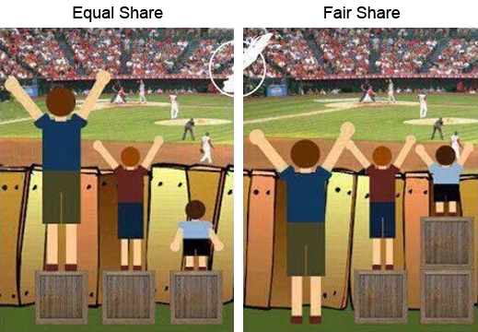
Equality of Access for SI Learners

Slide 3
Reasonable Adjustment Duty
Requires LAs and education providers to make reasonable adjustments to avoid placing a disabled child or young person at a substantial disadvantaged compared with others in accessing education

Slide 4
Purpose of RA duty
“is to provide access to an education as close as is reasonably possible to the standard normally offered to students at large”

Slide 5
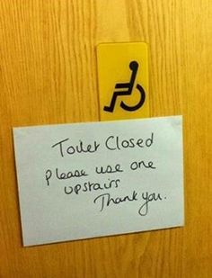
RA duty covers
Provision, criteria and practices
Auxiliary aids and services

Slide 6
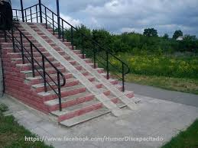
Physical features?
Excluded from the RA duty but there is a duty to plan for better access

Slide 7

The RA duty is anticipatory
Make the adjustments before the disadvantage is experienced

Slide 8
What is an auxiliary aid and service
“Legal cases have referred to the Oxford English Dictionary definition of auxiliary as ‘helpful, assistant, affording aid, rendering assistance, giving support or succour’ and that auxiliary aids and services ‘are things or persons which help’. DfE

Slide 9
So auxiliary aid and service could include:
Equipment
Specialist teaching support
Communication support / mobility support

Slide 10
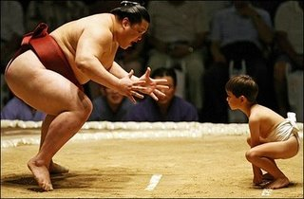
Substantial disadvantage
Anything more than minor or trivial

Slide 11


What is reasonable?

Slide 12
Very important question
“the crux of the RA duty is not whether something is an auxiliary aid or whether it is an adjustment to a practice, but whether it is something that is reasonable for the school to have to do. It is not possible for a school to justify a failure to make a reasonable adjustment; the question is only whether or not the adjustment is reasonable”

Slide 13
It depends
The Act does not say what is ‘reasonable’. This allows flexibility for different sets of circumstances so that, for example, what is reasonable in one set of circumstances may not be reasonable in another

Slide 14
Things to consider
Is support provided under the SEN framework. If provided through a EHC Plan then the RA duty does not apply
“The resources of the school. “It is more likely to be reasonable for a school with substantial financial resources to make an adjustment with a significant cost than for a school with fewer resources”

Slide 15
Things to consider
“The financial and other costs of making the adjustment”
The extent to which the step is effective in overcoming the disadvantage

Slide 16
Things to consider
The practicability of the adjustment
The effect of the disability on the individual
Health and safety requirements

Slide 17

Who pays
If RA duty is on both the LA and education establishments and the obligation on establishments varies according to circumstances, who pays for auxiliary aids and services?

Slide 18

Guidance ambiguous
If high needs LA through the SEN framework
Cannot assume education establishments have responsibility if not provided through SEN framework. Nor can it be assumed the LA is responsible

Slide 19
Local discretion
“When EY settings, schools and colleges, LAs and others plan and review special educational provision and make decisions about children and young people with SEN… they should consider, at the same time, the reasonable adjustments and access arrangements required for the same child or young person under the Equality Act.”
Advantages of a centrally funded pooled approach highlighted by both DfE and EHRC in its guidance

Slide 20
Local Offer content
information about “enabling available facilities to be accessed by disabled children and young people (this should include ancillary aids and assistive technology)”
what steps schools are taking to prevent disabled pupils being treated less favourably

Slide 21
PUBLIC SECTOR EQUALITY DUTY (PSED)
Applies to all public sector bodies including:
EY settings, schools, colleges, universities
Local Authorities
Ofsted

Slide 22
Section 149
Duty imposed on public bodies to have due regard to the need to:
eliminate discrimination, harassment, victimisation
advance equality of opportunity
foster good relations between persons who share a relevant protected characteristic and persons who do not share it

Slide 23
Application of S149
The Court of Appeal ruling:
The general equality duty not only applies to general formulation of policy but also applies to decisions made in applying policy in individual cases
(Pieretti v. Enfield Borough Council [2010] EWCA 1104, para 26 per Wilson LJ

Slide 24
What is “due regard”?
Examples for a LA:
needing to “consciously consider the need … to .. advance equality of opportunity” for CYP with SI when making decisions about support/equipment

Slide 25
What is “due regard”?
Examples:
considering the relevance and impact of the service equipment with have – “the greater the relevance and potential impact, the higher regard required by the duty”

Slide 26
What is “due regard”?
Examples:
ensuring the decisions on providing SI services take into full consideration the aims of the PSED
keeping a record of the decisions made about the provision of services and the reason for them

Slide 27
Advancing equality of opportunity
3 elements:
“remove or minimise disadvantages suffered by” CYP with SI
“take steps to meet the needs” of CYP with SI
“encourage” CYP with SI to participate in public life or in any other activity in which participation is low”

Slide 28
PSED and affordability
“whilst questions of available resources may form part of its decision-making consideration, a body cannot avoid complying with the duty by claiming that it does not have enough resources to do so. The courts have said that even where the context of decision making is financial resources in a tight budget, that does not excuse non-compliance with the duty and ‘indeed there is much to be said that in straitened times the need for clear, well informed decision making when assessing the impacts on less advantaged members of society is as great, if not greater’.”

